Slide 1
Preservative Alternatives
Final Presentation
December 10, 2024
Fadi Alsarhan, Carla Benato Milsted, Quinn Gavin,
Vig Karthik, Annika Luo, Maddie Sit
Notes:
30-45 min presentation, 1 hour allotted for entire presentation including Q&A

Slide 2
Outline
01
02
03
04
05
06
07
Background
Approach
Strategies
Technical Performance
Human & Environmental Health Performance
Remaining Questions
Alternative Strategies

Slide 3
Meet the Team
Fadi Alsarhan
PhD candidate in Chemistry
Carla B. Milsted
MS in Electrical Engineering and Computer Science
Quinn Gavin
MPH in Environmental Health Sciences
Vig Karthik
MPH in Health Policy & Management
Annika Luo
MS in Energy
and Resources
Maddie Sit
MPH in Environmental Health Sciences - Industrial Hygiene

Slide 4
01
Background
What are the current preservatives, and why are they concerning?
Background | Approach | Strategies | Technical Performance | Human & Environmental Health | Remaining Questions | Alternatives

Slide 5
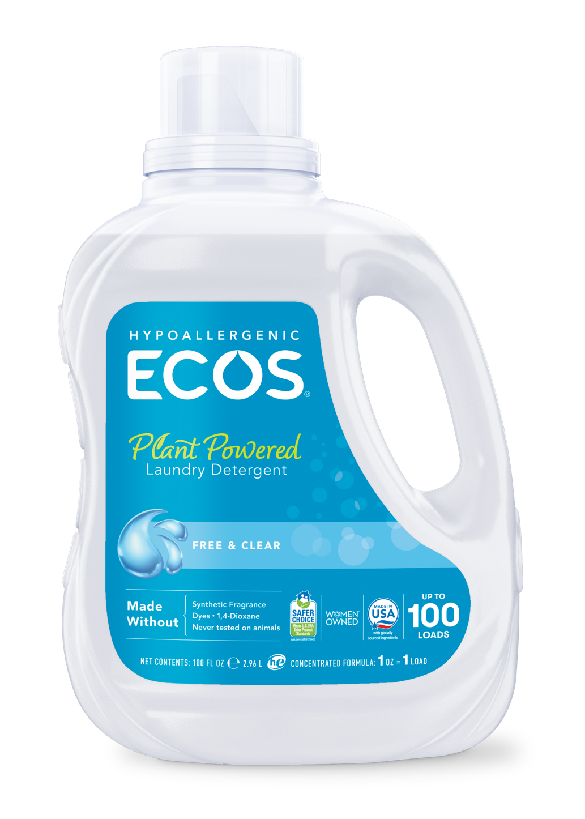
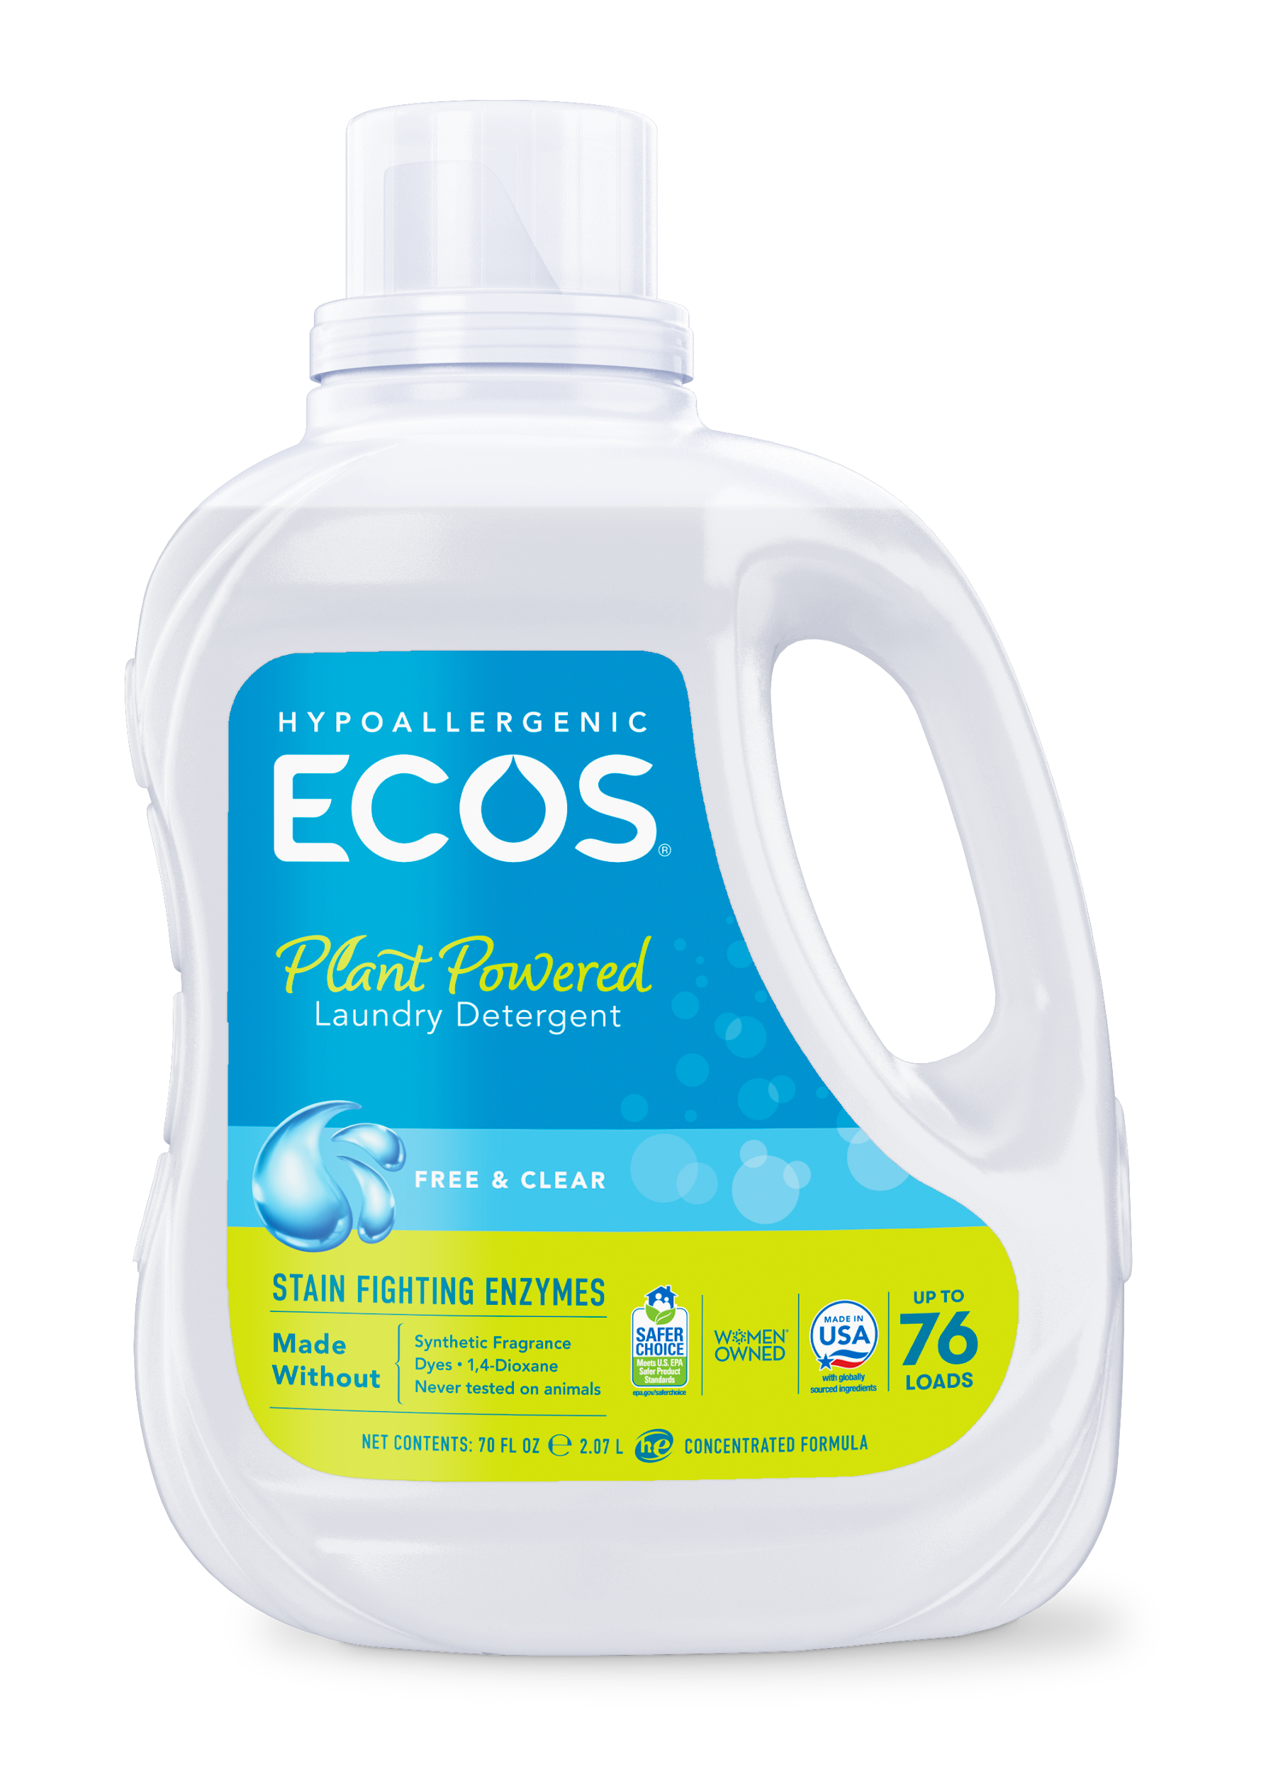
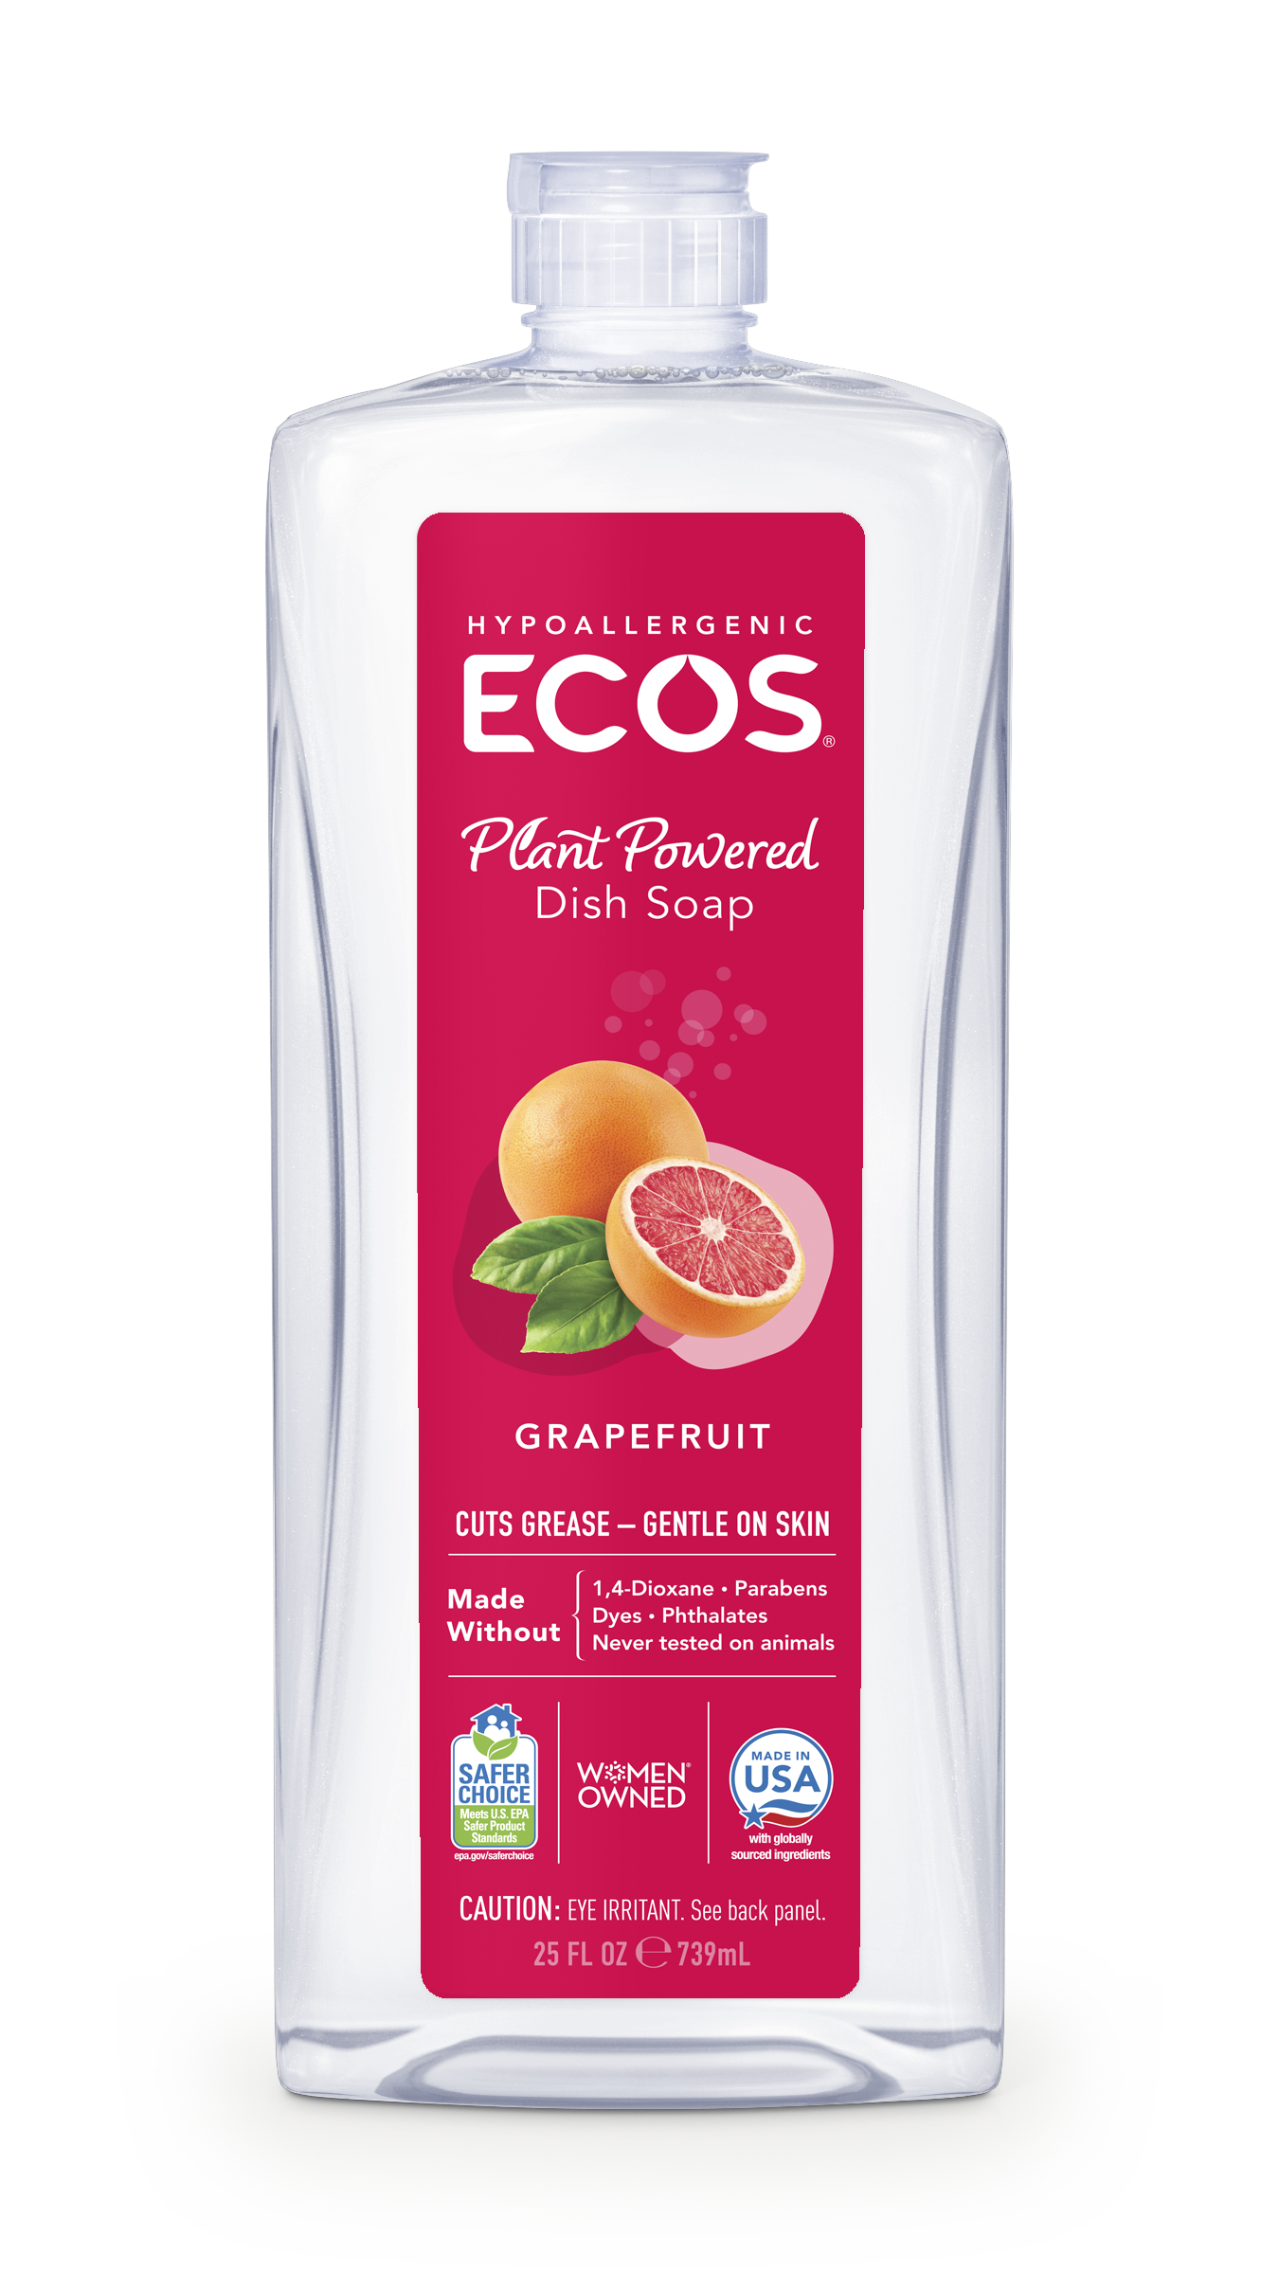
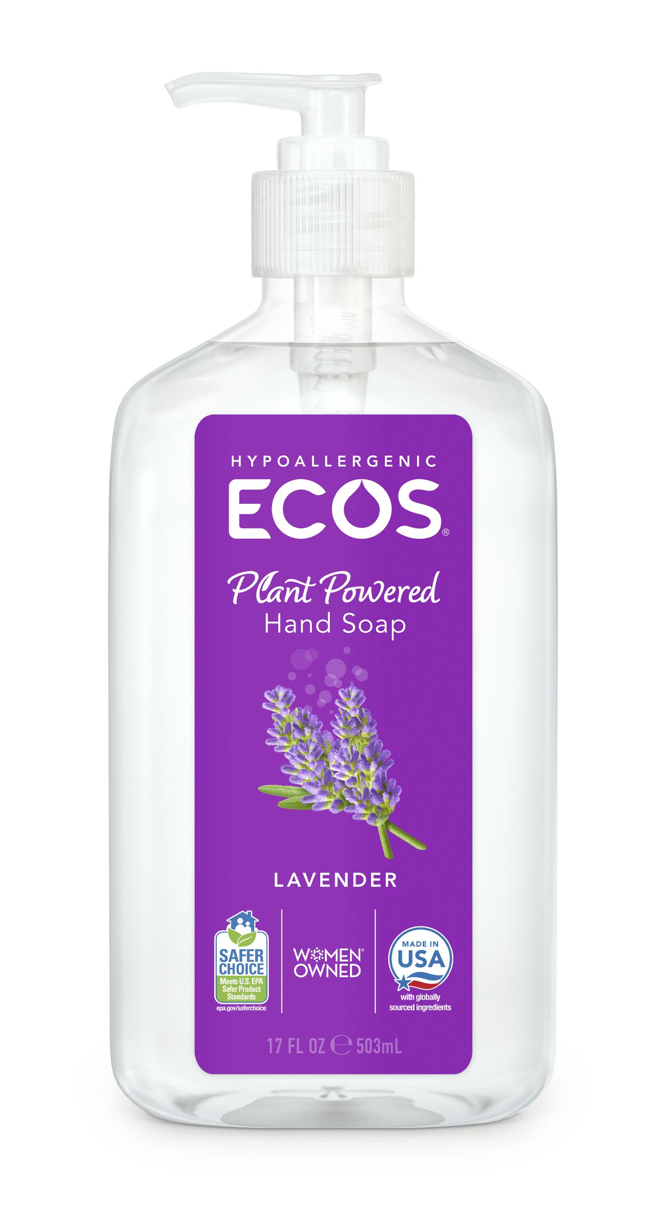
ECOS Products of Interest
Laundry Detergents
Dish Soap
Hand Soap
Phenoxyethanol (0.81%), boosted with ethylhexylglycerin (0.09%)
Phenoxyethanol (0.702%), boosted with ethylhexylglycerin (0.078%)
Phenoxyethanol (1%)
Phenoxyethanol (1%), boosted with caprylyl glycol (0.2%)
Source: ECOS
Background | Approach | Strategies | Technical Performance | Human & Environmental Health | Remaining Questions | Alternatives
Notes:
These are the ECOS products of interest but represent the broad classes of products in which we are replacing preservatives.
As shown here, products with phenoxyethanol and boosters
Other products use MIT

Slide 6
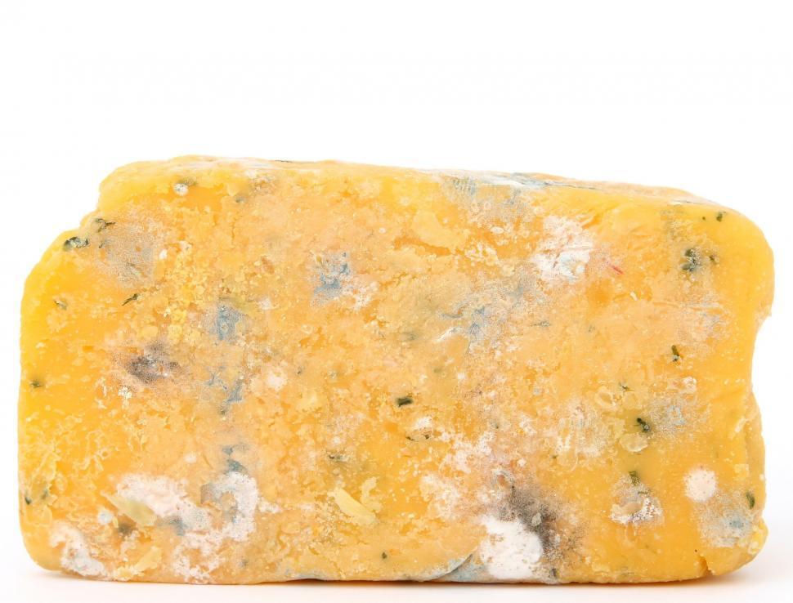
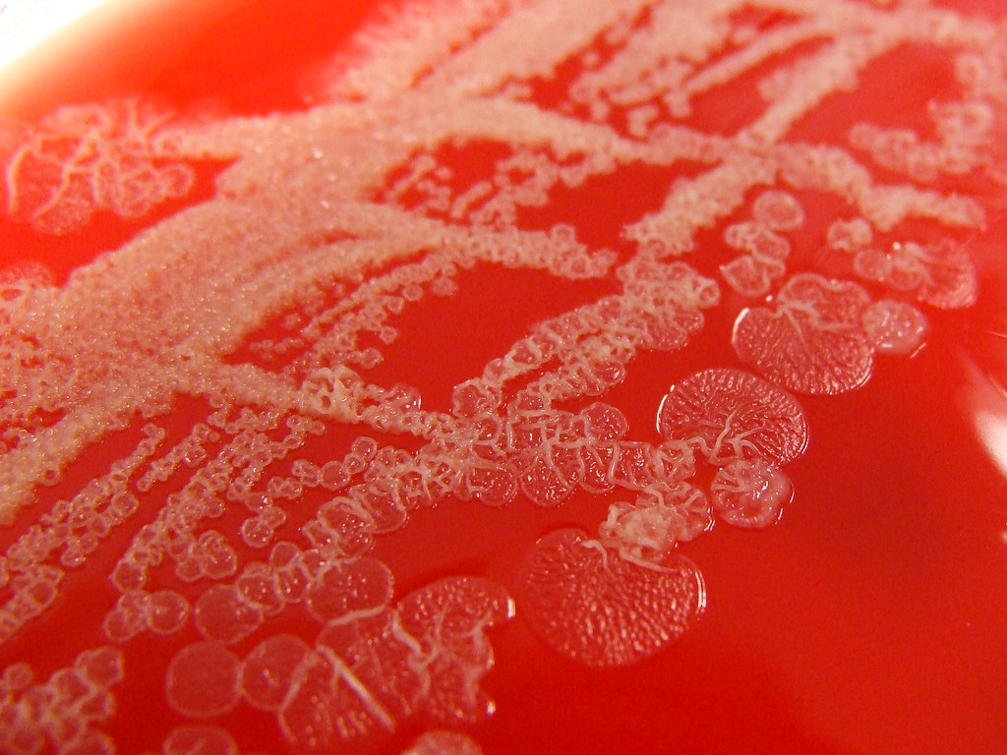
Preservatives prevent fungal and bacterial development
Source: Free Range
Source: Nathan Reading
Background | Approach | Strategies | Technical Performance | Human & Environmental Health | Remaining Questions | Alternatives
Notes:
Why preservatives?
Trying to prevent bacterial and fungal development in soaps.
Fungal development on soap on the left and bacterial development in agar on the right
The soap you see here is a solid unlike products we are trying to replace. That is because the preservatives do a pretty good job of preventing microbe development in liquid soaps.
The water content of the of liquid soaps is what allows the microbes to develop in the solution which is why the liquid soaps need more preservatives.
Focusing on liquid formulations but the microbes displayed are still the microbes that we are concerned with.
Agar: https://www.flickr.com/photos/nathanreading/7119244297
Soap: https://freerangestock.com/photos/87651/block-of-yellow-soap-on-white-background.html

Slide 7
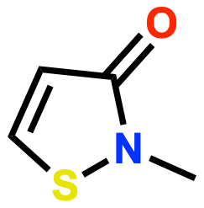
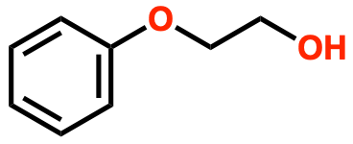
Two commonly used preservatives show several hazard traits
Methyl isothiazolinone (MIT)
Phenoxyethanol
Chemical | Group I Human |  |  | Group II and II* Human |  |  |  |  |  |  | Ecotoxicity | Fate | Physical Hazard
 | Carcinogenicity/ Mutagenicity | Developmental/ Reproductive Toxicity | Endocrine Activity | Acute Toxicity | Systemic Toxicity (Single and Repeat) | Neurotoxicity (Non-developmental, Single and Repeat) | Skin Sensitization* | Respiratory Sensitization* | Skin Irritation | Eye Irritation | Aquatic Acute/ Chronic | Persistence/ Bioaccumulation | Reactivity/ Flammability
MIT | L/L | L | DG | vH | M/DG | L/M | H | L | vH | vH | vH | L/vL | L
Phenoxyethanol | L | M/L | L | M | M/L | M/L | L | L | L | H | L/L | vL | L/L
Very low hazard | Low hazard | Moderate hazard | High hazard | Very high hazard | Data gap | High confidence | Low confidence
Background | Approach | Strategies | Technical Performance | Human & Environmental Health | Remaining Questions | Alternatives
Notes:
Phenoxyethanol and MIT are commonly used preservatives
This is a hazard table that was developed with the use of GHS guidelines, greenscreens, authoritative lists, and published literature.
We will discuss the creation of this more later.
As a note, if two endpoints in one cell had the same hazard level and confidence level they were denoted by one letter.
MIT
Human Health: Very high hazard for Acute Toxicity, Skin Irritation, Eye Irritation.
Phenoxyethanol as a preservative in soaps and detergents
Safe up to 1% by regulatory agencies, including the EU Cosmetics Regulation and the US FDA
Phenoxyethanol poses high hazard to eye irritation
Focusing on the entire hazard table but when evaluating the different strategies we focus on a subsetted list
Carcinogenicity/mutagenicity - if these are a concern then many of the other hazards are irrelevant because there is no safe dose of carcinogenic substances.
Skin sensitization/skin irritation - these will likely be in contact with skin as part of use so important to have low hazards
Eye irritation - Could potentially get into the eyes of consumers (unlikely but still possible)
Aquatic acute and chronic toxicity - These products go down the drain so it is important to consider
Fate (persistence/bioaccumulation) - Important to consider along with aquatic toxicity because if it persists in the environment any potential toxicity will be heightened just due to accumulation in organisms or the environment.
We will focus on a comparison of all of the hazards at the end but for the discussion of strategies we will limit to these endpoints as a focus for ones likely to be most impactful for soap and laundry detergent products.

Slide 8
Phenoxyethanol is efficacious with low health hazards, but alternatives need consideration
Phenoxyethanol is synthesized through the ethoxylation of a phenol
Ethylene oxide is a known carcinogen
Instances of skin sensitization have driven consumer concern
ECOS aims to get ahead of consumer concerns and replace phenoxyethanol
Ethylene oxide
Phenol
Phenoxyethanol
Background | Approach | Strategies | Technical Performance | Human & Environmental Health | Remaining Questions | Alternatives
Notes:
Why get rid of phenoxyethanol?
Phenoxyethanol was the next step after MIT and it reduces many of the hazards posed that you can see in MIT.
One, usually unconsidered, part of the hazard profile is the creation of phenoxyethanol
Uses ethylene oxide to ethoxylate the phenol
Ethylene oxide is a known cancer causing agent
Concerned with consumer perception of phenoxyethanol
There are some instances of allergic reactions from use of products with phenoxyethanol
Can be found when searching it on google creating negative consumer sentiment.

Slide 9
Boosters enhance preservative effectiveness
Combining preservatives with boosters can provide a wider spectrum and lower concentrations
Ethylhexylglycerin: used as a humectant, emollient, and antimicrobial booster
Caprylyl Glycol: used as a skin conditioning agent as well as an antimicrobial booster
Background | Approach | Strategies | Technical Performance | Human & Environmental Health | Remaining Questions | Alternatives
Notes:
Combining preservatives with boosters can offer several advantages in formulation:
Wider spectrum of antimicrobial activity:
This means the combination can effectively target a broader range of microorganisms.
For example, while one preservative might be excellent against bacteria, another might be more effective against fungi.
By combining them, you create a more comprehensive defense against various types of microbial contamination.
Lower concentrations of individual preservatives:
The synergistic effect allows for reduced amounts of each preservative.
This can help minimize potential irritation or sensitization risks.
EHG damages the cell membrane integrity and together with PE a synergistic action leads to rapid killing of E. coli associated with leakage of cellular constituents, disruption of the energy metabolism, morphological deformities of cells and condensation of DNA.
EHG, which acts like a soap (surfactant), helps PE work better by changing the surface of bacteria. This change supposedly allows PE to come into closer contact with the bacterial membrane.
Caprylyl glycol, with its amphiphilic structure, disrupts the cellular integrity of microorganisms by increasing the permeability of their cell membranes.
Together, they provide broad-spectrum protection against bacteria, yeasts, and molds.
Both Caprylyl glycol and Ethylhexylglycerin affect the cell membranes of microorganisms.
They increase the permeability of bacterial cell membranes, making them more susceptible to Phenoxyethanol's antimicrobial effects.
This synergistic action allows for more effective preservation at lower concentrations of Phenoxyethanol.
Important to highlight the fact that the mechanism of action for boosters is not well understood.

Slide 10
Our Challenge
We aim to identify safer preservatives that have similar or lower human and environmental health hazards than phenoxyethanol and retain or improve its efficacy.
Background | Approach | Strategies | Technical Performance | Human & Environmental Health | Remaining Questions | Alternatives

Slide 11
02
Approach
Replacing phenoxyethanol and MIT
Background | Approach | Strategies | Technical Performance | Human & Environmental Health | Remaining Questions | Alternatives

Slide 12
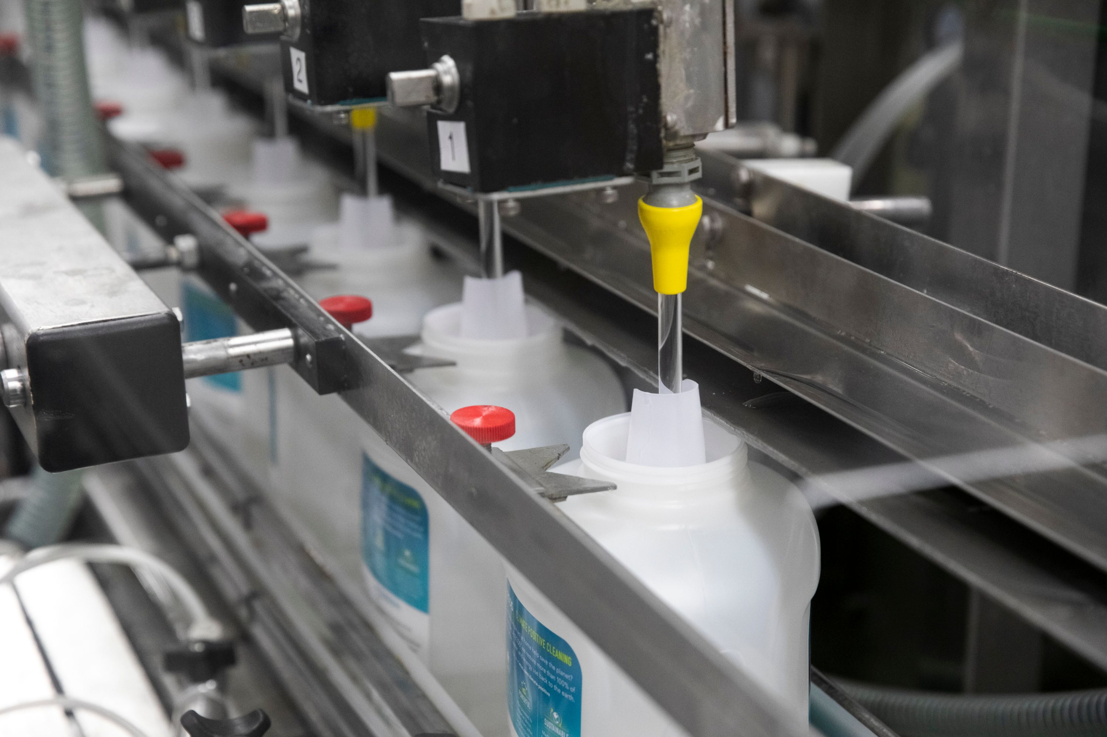
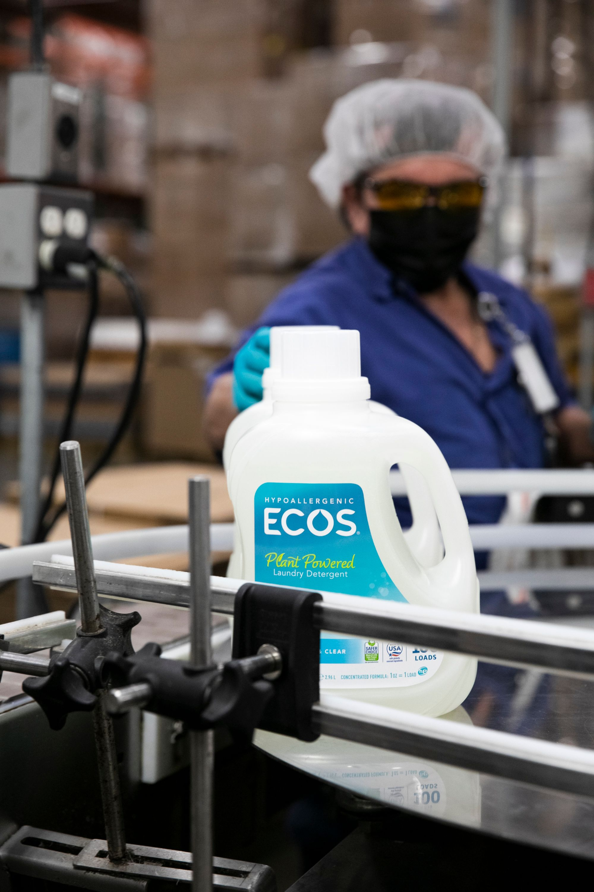
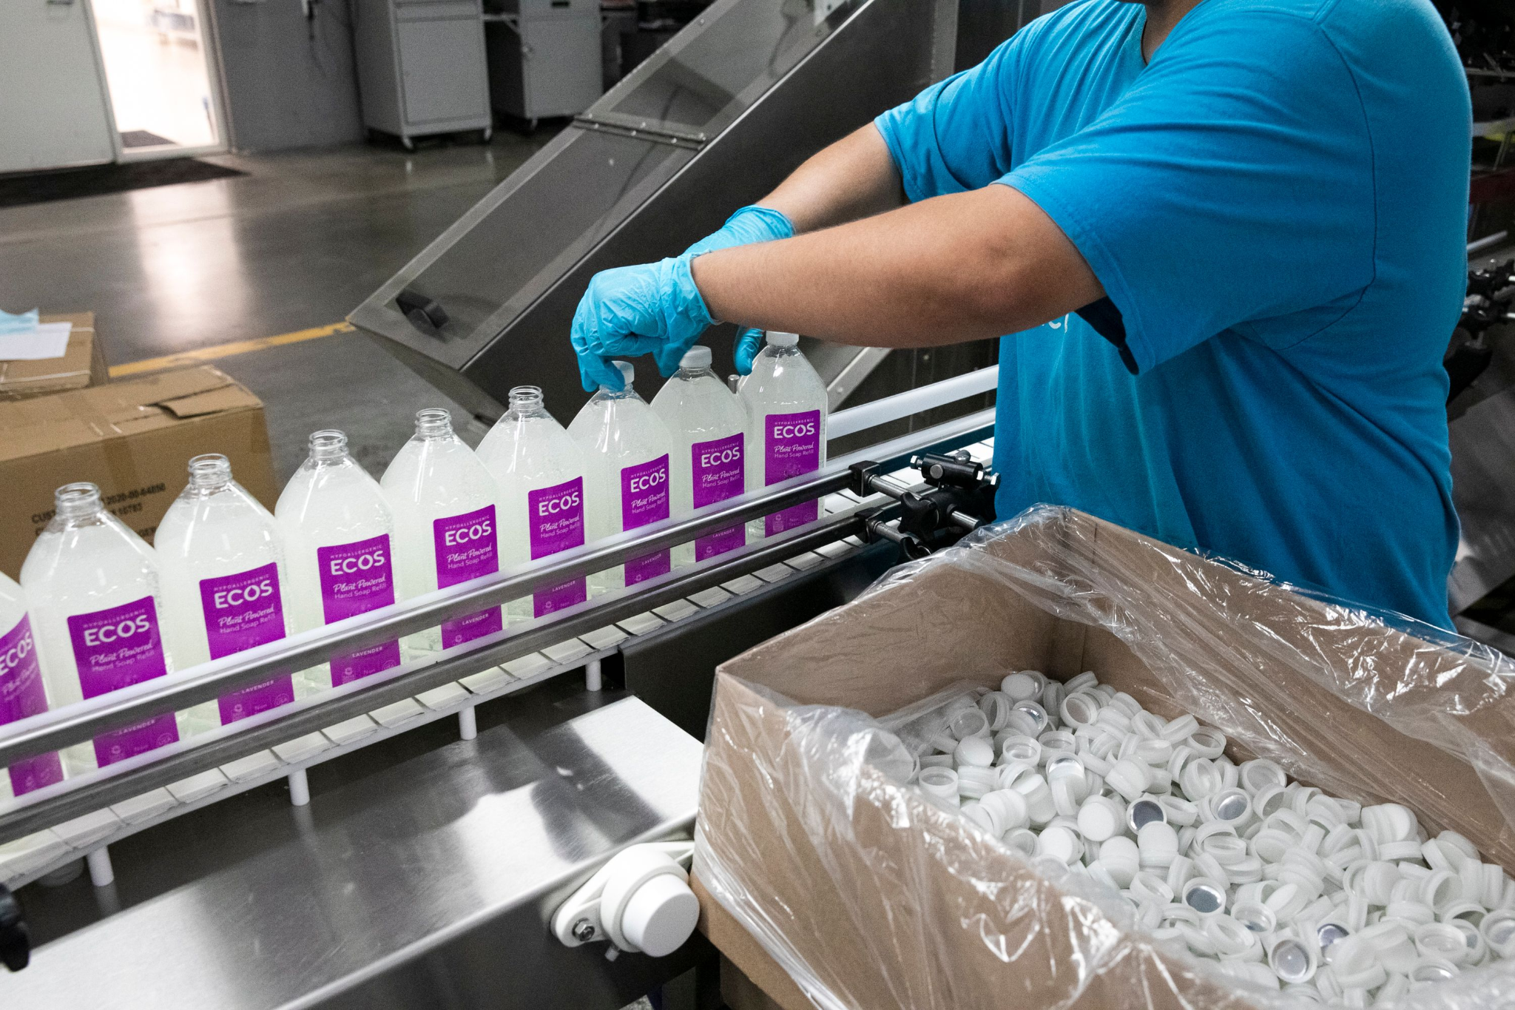
Alternative preservatives must comply with ECOS' standards
Preservatives must be effective in neutral to slightly basic pH
Laundry detergents: 6-8.5
Hand soaps: 6-8
Dish soaps: 7-9
Maintain product viscosity (500-1400 cp using a Brookfield viscometer, 50rpm)
Ensure enzyme stability for efficacy in detergents
Source: ECOS
Background | Approach | Strategies | Technical Performance | Human & Environmental Health | Remaining Questions | Alternatives
Notes:
Efficacy cannot be compromised, including foaming, stain removal, hand feel, grease cutting, etc.

Slide 13
Evaluation process for potential phenoxyethanol alternatives
Other soap/detergent companies
Other industries (cosmetics/skincare)
ECOS 2015 strategy list
Food preservatives
EPA Safer Chemicals Ingredients List
Alternative systems of production/chemical literature
Background | Approach | Strategies | Technical Performance | Human & Environmental Health | Remaining Questions | Alternatives

Slide 14
GreenScreen for Safer Chemicals: Hazard Assessment Guidance (2018) was followed
Reviewed:
Authoritative lists
GreenScreen Assessments
Scientific literature from Google Scholar and Pharos-PubMed searches
Safety data sheets (SDSs)
Interpretations:
Used GHS guidelines to classify hazards
Positive or no adverse health effects → low hazard
Multiple studies with consistent evidence or GreenScreen Assessment → high confidence
Only data source is SDS or contradicting evidence → low confidence
Very low hazard | Low hazard | Moderate hazard | High hazard | Very high hazard | Data gap | High confidence | Low confidence
Source: GreenScreen for Safer Chemicals V1.4, Section 11.2-11.3 (2018)
Background | Approach | Strategies | Technical Performance | Human & Environmental Health | Remaining Questions | Alternatives
Notes:
45 seconds
Used GHS (Globally Harmonized System) guidelines to interpret hazards from data sources and categorize

Slide 15
03
Strategies
Evaluating preservatives to replace phenoxyethanol and MIT
Background | Approach | Strategies | Technical Performance | Human & Environmental Health | Remaining Questions | Alternatives

Slide 16
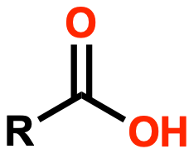
Strategy 1: Carboxylic Acids
Background | Approach | Strategies | Technical Performance | Human & Environmental Health | Remaining Questions | Alternatives
Notes:
Carboxylic acids are an organic compounds characterized by the presence of a carboxyl group attached to a carbon chain

Slide 17
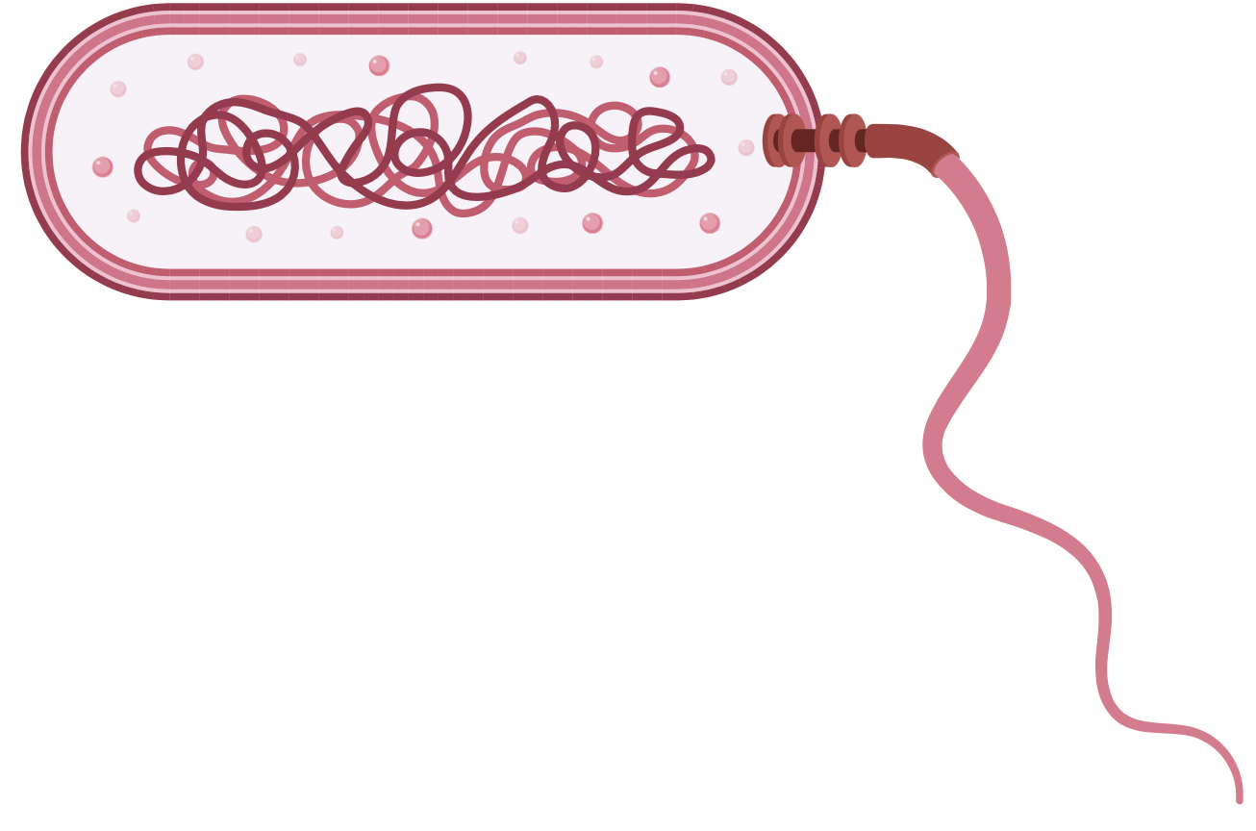
CAs’ ability to cross microbial membrane makes them an effective antibacterial
Background | Approach | Strategies | Technical Performance | Human & Environmental Health | Remaining Questions | Alternatives
Notes:
Focusing on carboxylic acids but many of these solutions follow a similar mechanism.
Lipophilic properties allow the carboxylic acids to bypass the microbial membrane and then once it is inside the bacteria it dissociates and acidifies causing breakdown of the membrane and messing with the proton gradient inside the cell.

Slide 18
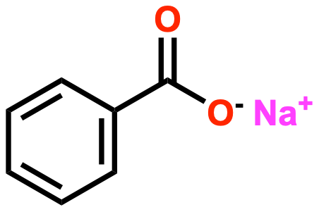
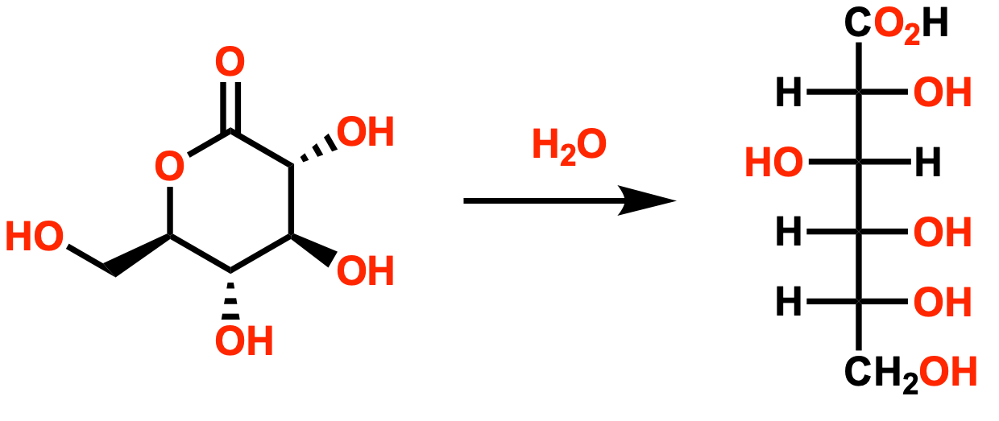
Carboxylic acids have demonstrated efficacy at lower pH in food preservation
Sodium Benzoate
Potassium Sorbate
Gluconolactone
Gluconic Acid
Sourcing
Current Uses
Naturally occurring in fruits/plants, and now chemically synthesized
Commonly used as preservatives in food and personal care products
Effective pH
Antimicrobial Activity
Maximum Approved Concentration
2.5-4
Antibacterial and antifungal
SB & PS: 0.1%
Gluconolactone: NCL
NCL: No concentration limit
Background | Approach | Strategies | Technical Performance | Human & Environmental Health | Remaining Questions | Alternatives
Notes:
Class of acids commonly used as preservatives in food and personal care products.
Sodium benzoate was actually the first preservative registered by FDA
Function most effectively at low pH (pH range 2.5 - 4.0)
Found in fruits, plants, and wine but chemically synthesized

Slide 19
Carboxylic acids have similar or lower hazards than incumbents
Chemical | Group I Human | Group II and II* Human |  |  | Ecotoxicity | Fate
 | Carcinogenicity/Mutagenicity | Skin Sensitization* | Skin Irritation | Eye Irritation | Aquatic Acute/Chronic | Persistence/Bioaccumulation
MIT | L/L | H | vH | vH | vH | L/vL
Phenoxyethanol | L | L | L | H | L/L | vL
Sodium benzoate | L/L | H | L | H | L/DG | L
Potassium sorbate | L/M | L | L | H | M | vL
Gluconolactone/ gluconic acid | L | L | L | L | L/L | vL
Very low hazard | Low hazard | Moderate hazard | High hazard | Very high hazard | Data gap | High confidence | Low confidence
Background | Approach | Strategies | Technical Performance | Human & Environmental Health | Remaining Questions | Alternatives

Slide 20
Strategy 2: Natural Preservatives - Rosemary Essential Oil & Willow Bark Extract
Source: Wisconsin Horticulture (2024)
Source: Healthline (2024)
Background | Approach | Strategies | Technical Performance | Human & Environmental Health | Remaining Questions | Alternatives
Notes:
Inspired by plants in the natural world that require protection from pests, microbes, and enviro stress
Need to deal with oxidative stress
Rosemary essential oil - preservative known to have antimicrobial properties
WB - from ECOS 2015 strategy list

Slide 21
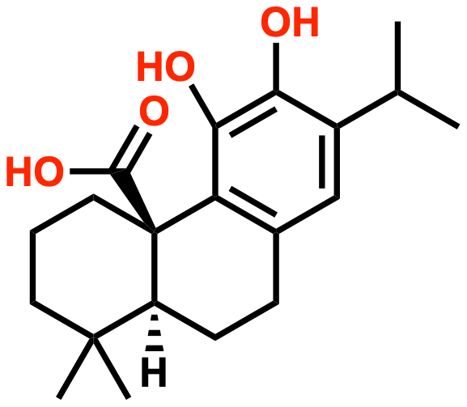
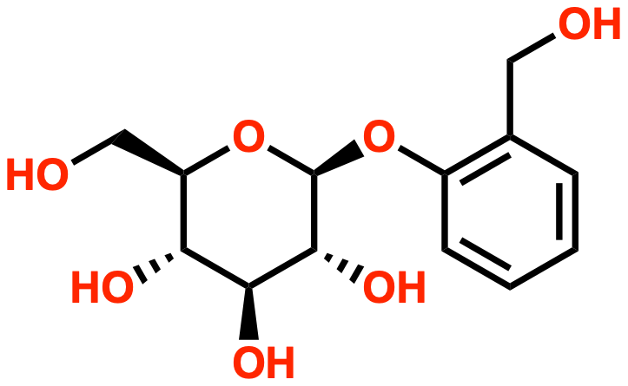
Naturally occurring antimicrobials/antibacterials are effective preservatives in consumer products
Rosemary essential oil contains carnosic acid
Willow bark extract contains salicin
Sourcing
Current Uses
Rosemary leaves and flowery top Bark of willow tree
REO: food preservative, soaps, shampoos
Willow bark: antiseptic, antibacterial in PCPs
Effective pH
Antimicrobial Activity
Maximum Approved Concentration
REO: ~7.4 Willow bark: 3-7
REO: antibacterial and antifungal
Willow bark: antibacterial only
REO: 0.5-0.7%*
Willow bark: 5%
*Based on yogurt preservation
Background | Approach | Strategies | Technical Performance | Human & Environmental Health | Remaining Questions | Alternatives
Notes:
REO and willow bark both contain phenolics which provide some form of antimicrobial effect
REO: one of main antimicrobial components is carnosic acid, works via membrane permeability
Other components: carnosol and cyclic diterpene diphenols
Willow bark: main antibacterial compound is salicin
Salicin forms salicylic acid when oxidized
Also contains flavonoids, lignin, and phenolic compounds in its leaves
Components of each (REO and WB) have synergistic properties that contribute to their antimicrobial/bacterial efficacies
Depends on combination of components, season of harvest, and location
Sourcing
Current uses
REO: history as food preservative
WB: salicin - antiseptic for wounds, pain relief (aspirin)
Antimicrobial
REO: covers entire spectrum as antimicrobial
WB: antibacterial only, requires additional chemicals for yeasts and mold
No max safe concentration, but here is what’s typically been used
—-----------------------------------------------
Carnosol is an oxidized form of carnosic acid
Challenge is batch to batch consistency
REO: Most effective against mold compared to yeast, gram negative, and gram positive bacteria
WB: best against gram positive bacteria
WB concentration: 2.5-5%
Mechanism as antimicrobial: membrane disruption and protein inhibition
Membrane Disruption:
Can permeate cell membrane, cause leakage of cellular components
Phenolic compounds can interact with the lipid bilayer of microbial cell membranes, causing increased permeability.
This disruption can lead to leakage of essential cellular components, such as proteins and ions, ultimately leading to cell death.
Protein Inhibition:
Binds to proteins and inhibits function, prevents microbial growth
Phenolics can bind to proteins, inhibiting their function.
They can interact with enzymes, interfering with metabolic processes and preventing microbial growth.

Slide 22
Natural alternatives have some lower hazards and data gaps than incumbents
Chemical | Group I Human | Group II and II* Human |  |  | Ecotoxicity | Fate
 | Carcinogenicity/Mutagenicity | Skin Sensitization* | Skin Irritation | Eye Irritation | Aquatic Acute/Chronic | Persistence/Bioaccumulation
MIT | L/L | H | vH | vH | vH | L/vL
Phenoxyethanol | L | L | L | H | L/L | vL
Rosemary essential oil | DG/M | M | L | DG | DG | L/DG
Willow bark extract | L | L | L | L | L/DG | DG
Very low hazard | Low hazard | Moderate hazard | High hazard | Very high hazard | Data gap | High confidence | Low confidence
Background | Approach | Strategies | Technical Performance | Human & Environmental Health | Remaining Questions | Alternatives
Notes:
Highlights
Both have more data gaps than incumbents
Rosemary worse for skin sensitization than phenoxyethanol
Willow bark overall pretty good across the board - hazard profile
Data gap for aquatic chronic tox and fate

Slide 23
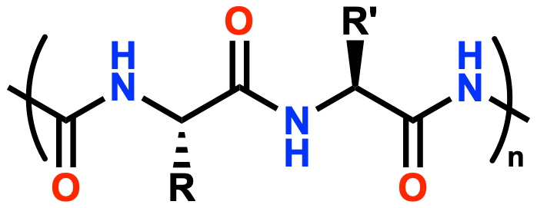
Strategy 3: Peptides
Background | Approach | Strategies | Technical Performance | Human & Environmental Health | Remaining Questions | Alternatives
Notes:
Carboxylic acids are an organic compounds characterized by the presence of a carboxyl group attached to a carbon chain

Slide 24
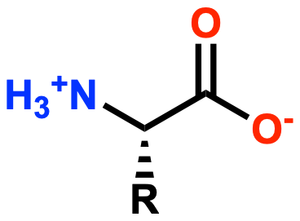
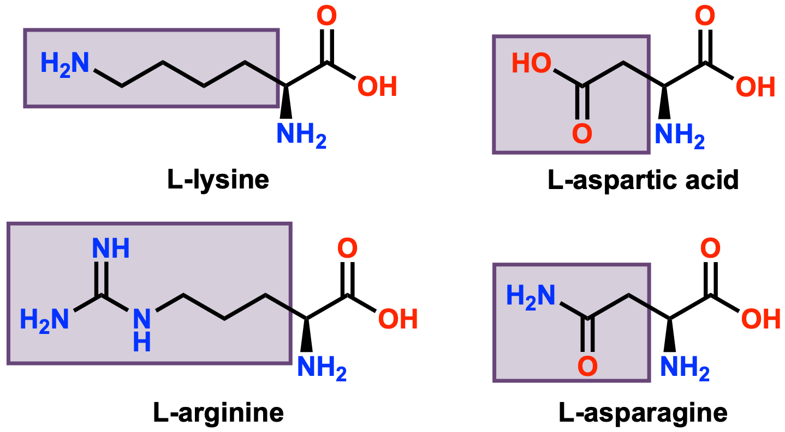
Peptides are oligomers of amino acids
Amino acid
Representative amino acid side chains
Peptide
Background | Approach | Strategies | Technical Performance | Human & Environmental Health | Remaining Questions | Alternatives

Slide 25
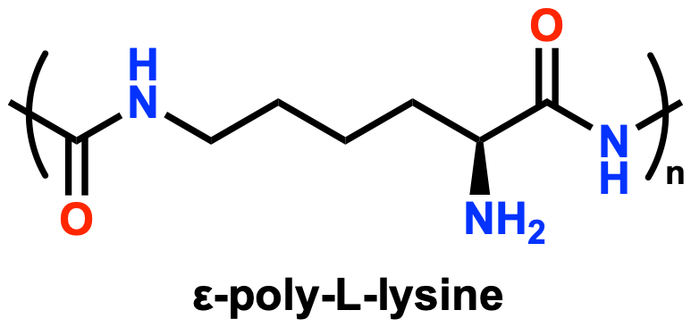
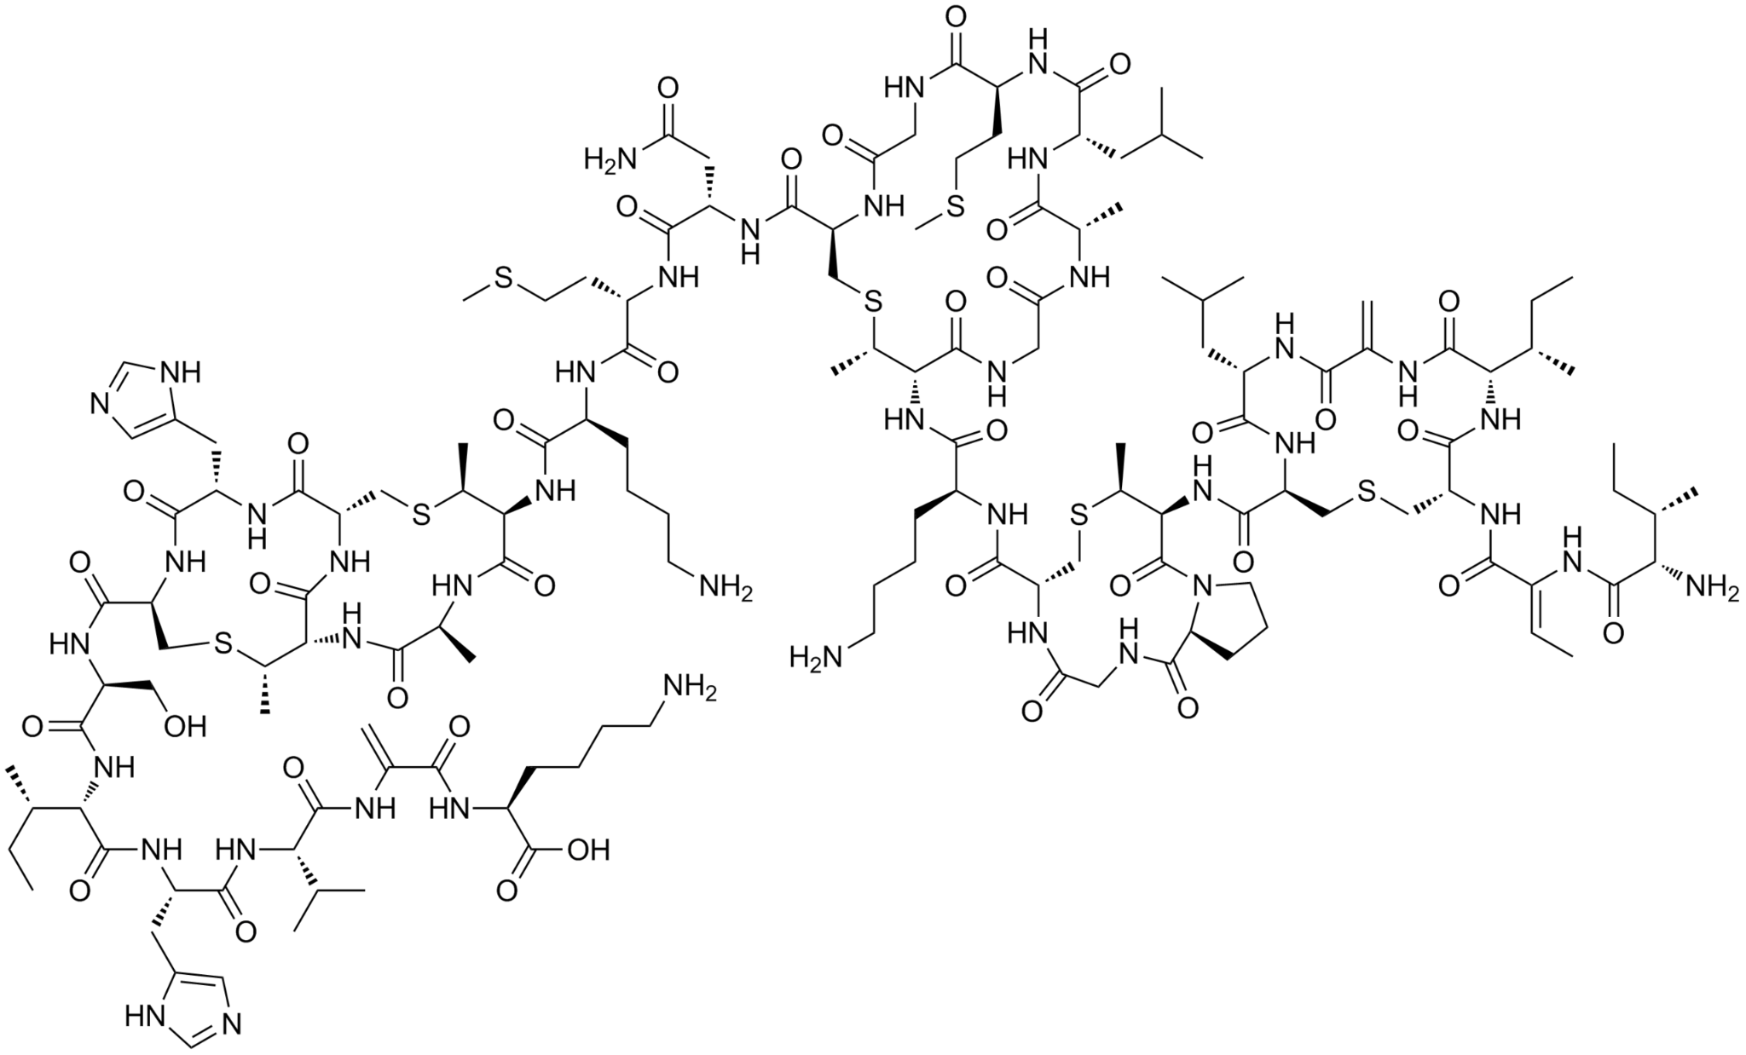
Peptides are used for food preservation
Nisin
Sourcing
Current uses
Biosynthesized by bacterial fermentation
Both approved for food preservation in USA & Japan. Nisin (E234) additionally approved for food preservation in EU.
Effective pH
Antimicrobial Activity
Maximum Approved Concentration
ε-poly-L-lysine: 5-9
Nisin: 2-7 (2-3 best)
ε-PL: antibacterial & antifungal
Nisin: antibacterial (mainly Gram +)
ε-PL: 0.005% in US, 0.05% in Japan
Nisin: 0.05%
Background | Approach | Strategies | Technical Performance | Human & Environmental Health | Remaining Questions | Alternatives
Notes:
poly-L-lysine pH range: https://pmc.ncbi.nlm.nih.gov/articles/PMC10433424/#:~:text=which%20was%20conducted%20on%20B,at%20this%20range%20%5B44%5D.
poly-L-lysine max concentration in US (GRAS notice): https://wayback.archive-it.org/7993/20171031053057/https://www.fda.gov/downloads/Food/IngredientsPackagingLabeling/GRAS/NoticeInventory/UCM267372.pdf

Slide 26
Peptides offer improved hazard profile over phenoxyethanol
Chemical | Group I Human | Group II and II* Human |  |  | Ecotoxicity | Fate
 | Carcinogenicity/Mutagenicity | Skin Sensitization* | Skin Irritation | Eye Irritation | Aquatic Acute/Chronic | Persistence/Bioaccumulation
MIT | L/L | H | vH | vH | vH | L/vL
Phenoxyethanol | L | L | L | H | L/L | vL
ε-poly-L-lysine | DG | L | L | L | DG | L
Nisin | L/DG | M | L | M | DG | L
Very low hazard | Low hazard | Moderate hazard | High hazard | Very high hazard | Data gap | High confidence | Low confidence
Background | Approach | Strategies | Technical Performance | Human & Environmental Health | Remaining Questions | Alternatives

Slide 27
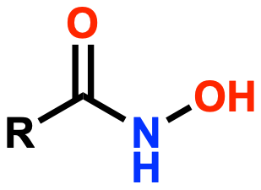
Strategy 4: Hydroxamic Acids
Background | Approach | Strategies | Technical Performance | Human & Environmental Health | Remaining Questions | Alternatives

Slide 28
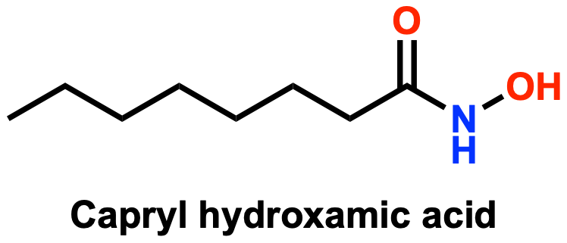
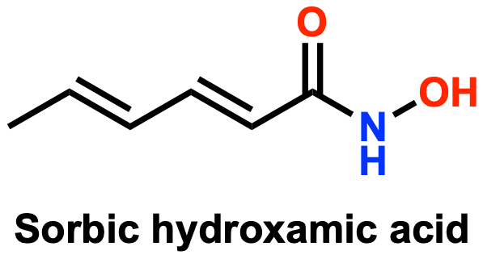
Hydroxamic acids are versatile derivatives of carboxylic acids
Sourcing
Current uses
Synthesized from corresponding carboxylic acids
Commonly used in 227 formulations as preservatives in cosmetic and household products
Effective pH
Antimicrobial Activity
Maximum Approved Concentration
4-8
Antibacterial & antifungal
Capryl: 0.3% in US
Sorbic: 0.1% (Not approved)
Background | Approach | Strategies | Technical Performance | Human & Environmental Health | Remaining Questions | Alternatives
Notes:
Reference https://www.cir-safety.org/sites/default/files/Caprylhydroxamic%20Acid.pdf (CIR US FDA External)
Sorbic acid - concentration people use, it has not been approved at any country but this is the concentration that people used.
Synthesized from corresponding carboxylic acids or derived from natural acids like caprylic or sorbic acids found in oils and plants
Organic compounds, function as mild, broad-spectrum antimicrobial agents
Caprylhydroxamic acid
Source: Derived from natural acids (e.g., caprylic acid) or synthesized
Key Benefits:
Broad-spectrum antimicrobial effective at pH 4–8
Forms strong complexes with metals and reacts with oxidizers/acids
Inhibits enzymes like ureases, peroxidases, and matrix metalloproteinases
Applications:
Used in 227 formulations, including bath soaps and detergents
Maximum safe concentration: 0.3% for detergents and soaps, 0.25% for cosmetics
Membrane disruption
The hydroxamic acid functional group makes Caprylhydroxamic Acid an excellent chelating agent. It is known that some bacteria synthesize and use hydroxamic acids as siderophores (iron scavengers/chelators).4 Additionally, Caprylhydroxamic Acid forms strong complexes with oxidized transition metals almost instantaneously, and it may react with oxidizers and acids.2 In general, hydroxamic acids are capable of the inhibition of a variety of enzymes, including ureases, peroxidases, and matrix metalloproteinases.5 (Data concerning the effects of Caprylhydroxamic Acid on enzyme activity were not found in the published literature.) Caprylhydroxamic Acid is stable under normal environmental and usage conditions. 2 However, at very high or low pH, it may be hydrolyzed to caprylic acid and hydroxylamine. Decomposition products at high temperature are ammonia and oxides of carbon and nitrogen.
Used in Cosmetics
Caprylhydroxamic Acid is reported to be used in 227 formulations 12 at maximum leave-on and rinse-off concentrations of 0.25% in body and hand products and 0.3% in bath soaps and detergents, respectively. 13 (Table 2) Caprylhydroxamic Acid is used in products applied near the eye at up to 0.2% (in eyebrow pencils and in “other” eye makeup preparations), in formulations that come into contact with mucous membranes at up to 0.3% (in bath soaps and detergents), and in baby lotions, oils, and creams at up to 0.15%.

Slide 29
Phenoxyethanol exceeds hydroxamic acids in ecotoxicity
Chemical | Group I Human | Group II and II* Human |  |  | Ecotoxicity | Fate
 | Carcinogenicity/Mutagenicity | Skin Sensitization* | Skin Irritation | Eye Irritation | Aquatic Acute/Chronic | Persistence/Bioaccumulation
MIT | L/L | H | vH | vH | vH | L/vL
Phenoxyethanol | L | L | L | H | L/L | vL
Capryl Hydroxamic Acid | DG/L | L | L | H | H | vL/vL
Sorbic Hydroxamic Acid | DG | M/H | H | H | DG | DG
Very low hazard | Low hazard | Moderate hazard | High hazard | Very high hazard | Data gap | High confidence | Low confidence
Background | Approach | Strategies | Technical Performance | Human & Environmental Health | Remaining Questions | Alternatives
Notes:
According to 2020 FDA Voluntary Cosmetic Registration Program (VCRP) survey data Caprylhydroxamic Acid is used at maximum leave-on and rinse-off concentrations of 0.25% in body and hand products and 0.3% in bath soaps, respectively.
Health and environmental performance: include hazard table w class chemicals w MIT and phenoxyethanol
Both capryl hydroxamic acid and sorbic hydroxamic acid have low sensitization and irritation
Potential ecotoxicity and environmental fate require more research
Remaining questions
Concentration, usage, and potential formulation efficacy
Use capryl hydroxamic acid or sorbic hydroxamic acid? Or in combination?

Slide 30
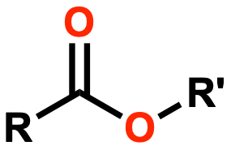
Strategy 5: Esters
Background | Approach | Strategies | Technical Performance | Human & Environmental Health | Remaining Questions | Alternatives
Notes:
Carboxylic acids are an organic compounds characterized by the presence of a carboxyl group attached to a carbon chain

Slide 31
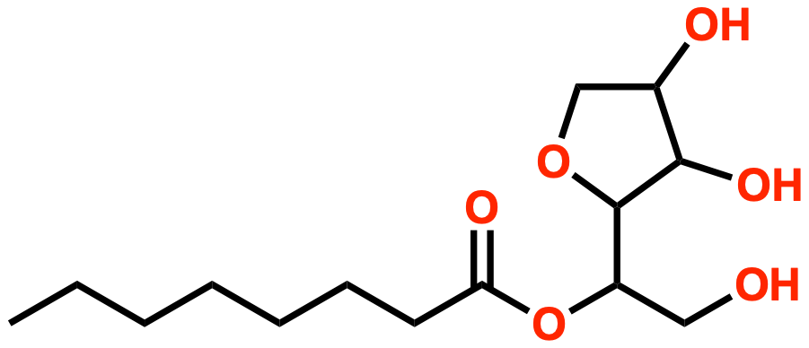
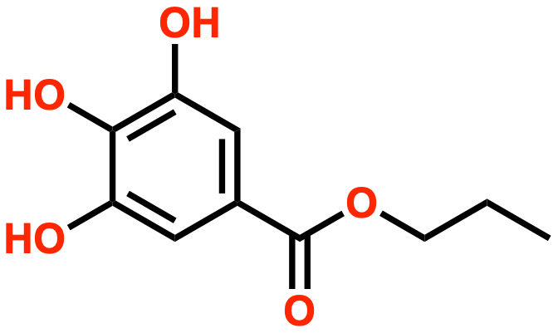
Esters demonstrate antimicrobial activity in cosmetics
Sorbitan caprylate
Propyl gallate
Sourcing
Current uses
Esterification reaction combining carboxylic acids with alcohol
Various - propyl gallate used in foods, sorbitan caprylate in cosmetics
Effective pH
Antimicrobial Activity
Maximum Approved Concentration
SC: 4-6.5
PG: 4-8
Antibacterial and antifungal
SC: 1.5%
PG: 0.1%
Background | Approach | Strategies | Technical Performance | Human & Environmental Health | Remaining Questions | Alternatives
Notes:
https://www.clariant.com/en/Solutions/Products/2014/05/02/12/33/Nipaguard-SCE
Nipaguard SCE
Antimicrobial Preservatives Part Two: Choosing a Preservative | American Pharmaceutical Review - The Review of American Pharmaceutical Business & Technology

Slide 32
Sorbitan caprylate has a safer hazard profile than phenoxyethanol
Chemical | Group I Human | Group II and II* Human |  |  | Ecotoxicity | Fate
 | Carcinogenicity/Mutagenicity | Skin Sensitization* | Skin Irritation | Eye Irritation | Aquatic Acute/Chronic | Persistence/Bioaccumulation
MIT | L/L | H | vH | vH | vH | L/vL
Phenoxyethanol | L | L | L | H | L/L | vL
Sorbitan caprylate | L | L | L | L | M | L
Propyl gallate | L/L | H | M | vH | vH | H/L
Very low hazard | Low hazard | Moderate hazard | High hazard | Very high hazard | Data gap | High confidence | Low confidence
Background | Approach | Strategies | Technical Performance | Human & Environmental Health | Remaining Questions | Alternatives

Slide 33
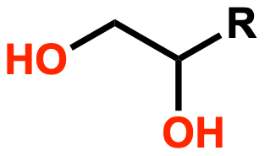
Strategy 6: Polyols
Background | Approach | Strategies | Technical Performance | Human & Environmental Health | Remaining Questions | Alternatives
Notes:
Polyols are organic compounds containing multiple hydroxyl groups (-OH) that function as humectants, solvents, and conditioning agents in cosmetic and personal care products.

Slide 34
EHG and CG are effective as preservatives on their own
Ethylhexylglycerin
Caprylyl glycol
Sourcing
Current Uses
EHG: palm or soybean
CG: in coconut oil, palm oil, and the milk of some mammals
EHG: humectant, emollient, antimicrobial booster
CG: skin conditioning agent, antimicrobial booster
Effective pH
Antimicrobial Activity
Maximum Approved Concentration
EHG: 3-12
CG: 3-8
EHG: antibacterial (gram +)
CG: antibacterial (gram +/-) and antifungal
EHG: 1%
CG: 1%
Background | Approach | Strategies | Technical Performance | Human & Environmental Health | Remaining Questions | Alternatives
Notes:
EHG: While it originates from plant-based sources, it's important to note that ethylhexylglycerin undergoes chemical processing and is considered a synthetic compound.
Derived from vegetable glycerin acquired from plant-based sources such as palm or soybean
Damages the cell membrane integrity
Prevents gram-positive bacteria from growing and multiplying
CG: Derived from caprylic acid, which is a fatty acid naturally found in coconut oil, palm oil, and the milk of some mammals
CG interfere with the integrity of microbial cell membranes, effectively disrupting their function

Slide 35
EHG and CG are effective as preservatives on their own
Ethylhexylglycerin
Caprylyl glycol
Sourcing
Current Uses
EHG: palm or soybean
CG: in coconut oil, palm oil, and the milk of some mammals
EHG: humectant, emollient, antimicrobial booster
CG: skin conditioning agent, antimicrobial booster
Effective pH
Antimicrobial Activity
Maximum Approved Concentration
EHG: 3-12
CG: 3-8
EHG: antibacterial (gram +)
CG: antibacterial (gram +/-) and antifungal
EHG: 1%
CG: 1%
Source: Langsrud S. et al. (2016)
Background | Approach | Strategies | Technical Performance | Human & Environmental Health | Remaining Questions | Alternatives
Notes:
EHG: While it originates from plant-based sources, it's important to note that ethylhexylglycerin undergoes chemical processing and is considered a synthetic compound.
Derived from vegetable glycerin acquired from plant-based sources such as palm or soybean
Damages the cell membrane integrity
Prevents gram-positive bacteria from growing and multiplying
CG: Derived from caprylic acid, which is a fatty acid naturally found in coconut oil, palm oil, and the milk of some mammals
CG interfere with the integrity of microbial cell membranes, effectively disrupting their function

Slide 36
EHG and CG are more hazardous than phenoxyethanol
Chemical | Group I Human | Group II and II* Human |  |  | Ecotoxicity | Fate
 | Carcinogenicity/Mutagenicity | Skin Sensitization* | Skin Irritation | Eye Irritation | Aquatic Acute/Chronic | Persistence/Bioaccumulation
MIT | L/L | H | vH | vH | vH | L/vL
Phenoxyethanol | L | L | L | H | L/L | vL
Ethylhexylglycerin | L/L | M | L | vH | M/M | M
Caprylyl glycol | L/L | L | L | H | H/M | vL
Very low hazard | Low hazard | Moderate hazard | High hazard | Very high hazard | Data gap | High confidence | Low confidence
Background | Approach | Strategies | Technical Performance | Human & Environmental Health | Remaining Questions | Alternatives

Slide 37
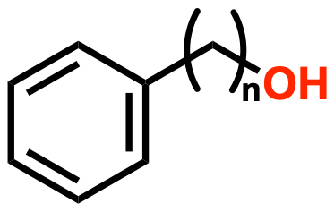
Strategy 7: Phenyl Alkyl Alcohols
Background | Approach | Strategies | Technical Performance | Human & Environmental Health | Remaining Questions | Alternatives
Notes:
Class of aromatic alcohols, widely used preservatives

Slide 38
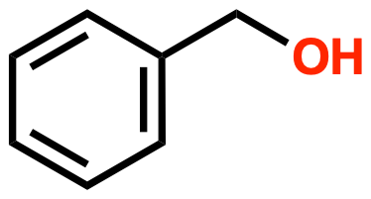
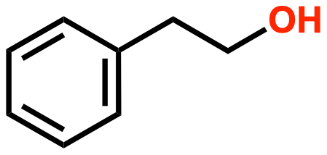
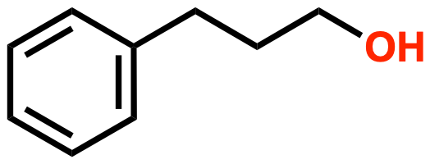
Phenyl alkyl alcohols are used for multiple purposes in various consumer products
Benzyl Alcohol
Phenethyl Alcohol
Phenylpropanol
Sourcing
Current Uses
Fruits, plant extracts, and wine but chemically synthesized
Preservative, fragrance, or solvent in detergents, soaps, cosmetics, personal care, and food products
Effective pH
Antimicrobial Activity
Maximum Approved Concentration
3-10
Antibacterial and antifungal
Benzyl alcohol: 1%
Phenethyl alcohol: 2.5%
Phenylpropanol: 0.3%
Background | Approach | Strategies | Technical Performance | Human & Environmental Health | Remaining Questions | Alternatives
Notes:
Benzyl alcohol is well studied preservative
Inspo from ECOS 2015 list - benzyl alcohol and phenethyl alcohol
A phenyl group (a benzene ring) is attached to an alkyl group (chain of carbon atoms), which is then connected to a hydroxyl group (-OH)
Main difference is # of carbons in the chain
Benzyl alcohol has one carbon, phenethyl alcohol has two carbons, and phenylpropanol has three carbons in that chain
Benzyl alcohol is a type of phenyl alkyl alcohol with a short alkyl chain and consists of a benzene ring attached to a methanol group
Phenethyl alcohol - almost the same as phenyl alkyl alcohol, except the alkyl chain specifically has an ethyl group of two carbon atoms attached to the phenyl ring
Phenylpropanol has one carbon longer chain compared to benzyl alcohol and phenethyl alcohol
Sourcing
Berries, flowers
Uses
Could be used in flower-scented product (floral fragrance)
pH
Most effective in acidic conditions
Antimicrobial
Benzyl alcohol is most potent antimicrobial compared to other alcohols (most effective at lower concentrations)
Lowest MIC values (presented later)
Disrupts structure of cell membranes of microorganisms, causes rapid denaturation of proteins, leads to cell lysis and death
__________________________
Concentration
Phenylpropanol: typically used up to 0.3% as preservative
Benzyl alcohol: 1%
Phenethyl alcohol: up to 2.5% in cosmetic formulations

Slide 39
Benzyl alcohol’s hazards are most similar to phenoxyethanol
Chemical | Group I Human | Group II and II* Human |  |  | Ecotoxicity | Fate
 | Carcinogenicity/Mutagenicity | Skin Sensitization* | Skin Irritation | Eye Irritation | Aquatic Acute/Chronic | Persistence/Bioaccumulation
MIT | L/L | H | vH | vH | vH | L/vL
Phenoxyethanol | L | L | L | H | L/L | vL
Benzyl alcohol | L | H | L | H | L | vL
Phenethyl alcohol | DG/L | L | L | M | M/DG | L
Phenylpropanol | DG/L | M | M | vH | M/DG | L
Very low hazard | Low hazard | Moderate hazard | High hazard | Very high hazard | Data gap | High confidence | Low confidence
Background | Approach | Strategies | Technical Performance | Human & Environmental Health | Remaining Questions | Alternatives
Notes:
Highlights
Benzyl alcohol most similar to phenoxy except worse for skin sensitization
Also used a ton and has most data
Hazard info from GreenScreen assessment
Phenethyl alcohol could be good option
Lower eye hazard than incumbents; even with moderate hazard - less relevant)
Aquatic could be concerning (low confidence)

Slide 40
04
Technical Performance
MIC values are used to determine effectiveness of preservatives
Background | Approach | Strategies | Technical Performance | Human & Environmental Health | Remaining Questions | Alternatives

Slide 41
A potent preservative has a low minimum inhibitory concentration
MIC is the lowest concentration of some chemical that prevents in vitro microbial growth
Measured in μg/mL = mg/L = ppm
USP <51> is the standard for antimicrobial testing
Product is inoculated with microbes
CFUs are counted at 7, 14, and 28 days
Bacteria should have 2 log reduction in CFUs
Fungi should not have any extra growth from initial population
The lower the MIC value, the less preservative needs to be used
Background | Approach | Strategies | Technical Performance | Human & Environmental Health | Remaining Questions | Alternatives
Notes:
45 seconds
Used GHS (Globally Harmonized System) guidelines to interpret hazards from data sources and categorize

Slide 42
Alternatives have comparable potency to phenoxyethanol
Chemical | MIC Value (µg/mL)
 | A. niger (Mold) | C. albicans (Yeast) | E. coli (Gram -) | P. aeruginosa (Gram -) | S. aureus (Gram +)
Phenoxyethanol | 1500 | 2000 | 2500 | 2500 | 3000
MIT | 0.5 | 0.5 | 41 | 30 | 20
Sodium benzoate | A. flavus 50 | 2.5 | 5 | 5 | 10
Potassium sorbate | A. flavus 50 | 50 | 5 | 10 | 10
Gluconolactone | Data gap | Data gap | 4000 | 4000 | 4000
Rosemary essential oil | A. flavus 250 | 5,000-10,000 (carnosol: 100) | 3,000-20,000 | 1,000 | 11,250 (carnosol: 32-256)
Willow bark extract | Data gap | Data gap | None (SA: 4,000) | Salicylic acid: 500 | 600-800 (SA: 4,000)
ε-poly-L-lysine | 250 | 250 | 12.5 | 50 | 12.5
Nisin | A. oryzae 256 | Data gap | 40 | 92 | 8
Caprylhydroxamic acid | A. brasiliensis 100 | 320 | Data gap | 1000 | Data gap
≤100 | >100 | No effect | Data gap
Background | Approach | Strategies | Technical Performance | Human & Environmental Health | Remaining Questions | Alternatives
Notes:
Fadi
10,000 ppm = 10,000 μg/mL = 10,000 mg/L = 1% (v/v) = 1% (w/v)
This is assuming that the density is ~1 g/mL; otherwise, v/v and w/v % are different
Highlight data gaps
Rosemary and willow bark (most MIC values from assignment 6)
Season of harvest and location affected activity of extracts
Willow bark: salicin is primary antibacterial compound, which gets metabolized to salicylic acid
Sources
Rosemary A. flavus: da Silva Bomfim et al. 2020
Rosemary S. aureus: Bowbe et al. 2023; carnosol S. aureus: Shen et al. 2020
Carnosol C. albicans: Yang et al. 2022
Willow bark P. aeruginosa: Adamczak et al. 2019
SAM S. aureus and E. coli: Song et al. 2022
Phenethyl alcohol A. flavus: Boukaew 2018
Phenethyl alcohol P. aeruginosa: Fraud et al. 2003
Phenethyl alcohol C. albicans: Majdabadi et al. 2018
Phenethyl alcohol E. coli: Kleinwächter et al. 2021
Nisin P. aeruginosa MIC https://www.mdpi.com/2076-2607/12/6/1230
Nisin MICs (converted from uM) https://pmc.ncbi.nlm.nih.gov/articles/PMC5981070/#B1
Nisin MICs https://journals.asm.org/doi/10.1128/aac.44.1.24-29.2000
Poly lysine MIC (aspergillus) https://www.jncamericany.com/product-list/polylysine/

Slide 43
Alternatives have comparable potency to phenoxyethanol
Chemical | MIC Value (µg/mL)
 | A. niger (Mold) | C. albicans (Yeast) | E. coli (Gram -) | P. aeruginosa (Gram -) | S. aureus (Gram +)
Phenoxyethanol | 1500 | 2000 | 2500 | 2500 | 3000
MIT | 0.5 | 0.5 | 41 | 30 | 20
Sorbic hydroxamic acid | 500 | Data gap | Data gap | Data gap | Data gap
Propyl gallate | A. brasiliensis 1000 | Data gap | 312.5-625 | 100 | 200-800
Sorbitan caprylate | A. brasiliensis 100 | >50 | >50 | >1000 | Data gap
Ethylhexylglycerin | 1500 | 1,500 | 1,500 | 2,000 | 1,500
Caprylyl glycol | 1000 | 2,000 | 1,000 | 2,000 | 2,000
Benzyl alcohol | 46.2 | 23.1 | 1.5 | 18.5 | 0.1
Phenethyl alcohol | 1000 | 800-3,200 | 1,800 | 4,600 | 5,000
Phenylpropanol | A. brasiliensis 1000 | Data gap | Data gap | 10,000 | Data gap
≤100 | >100 | No effect | Data gap
Background | Approach | Strategies | Technical Performance | Human & Environmental Health | Remaining Questions | Alternatives
Notes:
Fadi
Paper to EHG and CG: https://www.kuraray.eu/fileadmin/product_ranges/isopentyldio/downloads/IPD_bacteriostatic_effect_-_white_paper_final2.pdf
Rosemary and willow bark (most MIC values from assignment 6)
Season of harvest and location affected activity of extracts
Willow bark: salicin is primary antibacterial compound, which gets metabolized to salicylic acid
Sources
Rosemary A. flavus: da Silva Bomfim et al. 2020
Rosemary S. aureus: Bowbe et al. 2023; carnosol S. aureus: Shen et al. 2020
Carnosol C. albicans: Yang et al. 2022
Willow bark P. aeruginosa: Adamczak et al. 2019
SAM S. aureus and E. coli: Song et al. 2022
Phenethyl alcohol A. flavus: Boukaew 2018
Phenethyl alcohol P. aeruginosa: Fraud et al. 2003
Phenethyl alcohol C. albicans: Majdabadi et al. 2018
Phenethyl alcohol E. coli: Kleinwächter et al. 2021

Slide 44
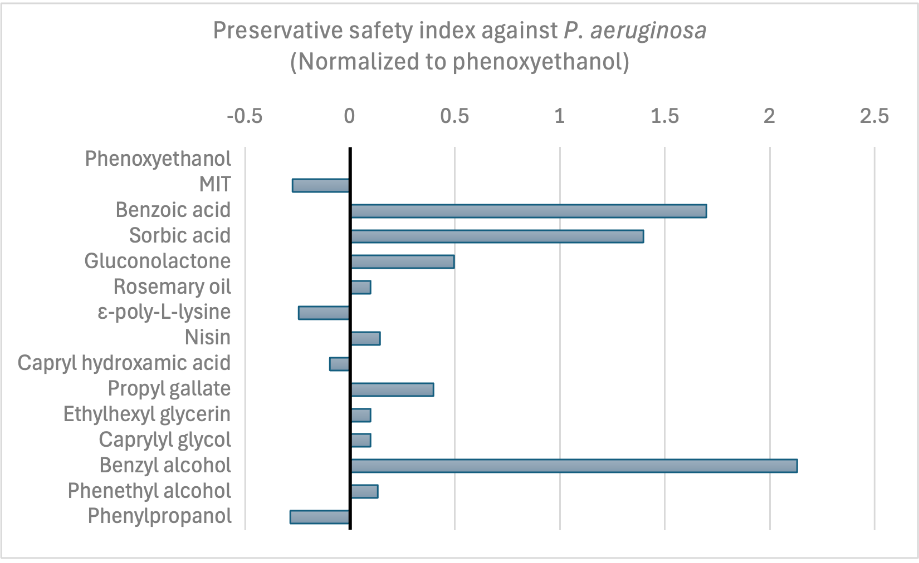
Some alternatives have a higher safety index than phenoxyethanol
Safety index = maximum approved concentration / MIC
A large number indicates a wide margin between safety and efficacy
Normalized to phenoxyethanol (safety index of 4 against P. aeruginosa)
Plotted using a symmetric log10 function
Positive is better than phenoxyethanol
Negative is worse than phenoxyethanol
Background | Approach | Strategies | Technical Performance | Human & Environmental Health | Remaining Questions | Alternatives
Notes:
45 seconds
Used GHS (Globally Harmonized System) guidelines to interpret hazards from data sources and categorize

Slide 45
05
Human & Environmental Health Performance
Background | Approach | Strategies | Technical Performance | Human & Environmental Health | Remaining Questions | Alternatives
Notes:
Maddie

Slide 46
Phenoxyethanol has close performers re: hazard identification
Chemical | Group I Human |  |  | Group II and II* Human
 | Carcinogenicity/ Mutagenicity | Reproductive/ Developmental Toxicity | Endocrine Activity | Acute Toxicity | Systemic Toxicity (Single and Repeat) | Neurotoxicity (Non-developmental, Single and Repeat) | Skin Sensitization* | Respiratory Sensitization* | Skin Irritation | Eye Irritation
Phenoxyethanol | L | L/M | L | M | M/L | M/L | L | L | L | H
MIT | L/L | L | DG | vH | M/DG | L/M | H | L | vH | vH
Potassium sorbate | L/M | L | DG | L | L | L | L | L | L | H
Gluconolactone | L | L | DG | L | L | DG | L | DG | L | L
Rosemary essential oil | DG/M | H | DG | L | DG/M | DG | M | DG | L | DG
Willow bark extract | L | DG | DG | L | DG | DG/L | L | DG | L | L
ɛ-poly-L-lysine | L | DG/L | DG | L | L | DG | L | L | L | L
Caprylhydroxamic acid | DG/L | DG/L | DG | L | DG/M | DG | L | DG | L | H
Sorbitan caprylate | L | L | DG | L | L | DG/L | L | DG | L | L
Caprylyl glycol | L/L | L | L | L | L | M/L | L | DG | L | H
Benzyl alcohol | L | L/M | DG | M | DG/L | M | H | L | L | H
Background | Approach | Strategies | Technical Performance | Human & Environmental Health | Remaining Questions | Alternatives

Slide 47
Phenoxyethanol has close performers re: hazard identification
Chemical | Group I Human |  |  | Group II and II* Human
 | Carcinogenicity/ Mutagenicity | Reproductive/ Developmental Toxicity | Endocrine Activity | Acute Toxicity | Systemic Toxicity (Single and Repeat) | Neurotoxicity (Non-developmental, Single and Repeat) | Skin Sensitization* | Respiratory Sensitization* | Skin Irritation | Eye Irritation
Phenoxyethanol | L | L/M | L | M | M/L | M/L | L | L | L | H
MIT | L/L | L | DG | vH | M/DG | L/M | H | L | vH | vH
Potassium sorbate | L/M | L | DG | L | L | L | L | L | L | H
Gluconolactone | L | L | DG | L | L | DG | L | DG | L | L
Rosemary essential oil | DG/M | H | DG | L | DG/M | DG | M | DG | L | DG
Willow bark extract | L | DG | DG | L | DG | DG/L | L | DG | L | L
ɛ-poly-L-lysine | L | DG/L | DG | L | L | DG | L | L | L | L
Caprylhydroxamic acid | DG/L | DG/L | DG | L | DG/M | DG | L | DG | L | H
Sorbitan caprylate | L | L | DG | L | L | DG/L | L | DG | L | L
Caprylyl glycol | L/L | L | L | L | L | M/L | L | DG | L | H
Benzyl alcohol | L | L/M | DG | M | DG/L | M | H | L | L | H
Very low hazard | Low hazard | Moderate hazard | High hazard | Very high hazard | Data gap | High confidence | Low confidence

Slide 48
Several alternatives have similar environmental hazards
Chemical | Ecotoxicity | Fate | Physical Hazard
 | Aquatic Acute/ Chronic | Persistence/ Bioaccumulation | Reactivity/ Flammability
Phenoxyethanol | L/L | vL | L/L
MIT | vH | L/vL | L
Potassium sorbate | M | vL | L/L
Gluconolactone | L/L | vL | L/L
Rosemary essential oil | DG | L/DG | DG
Willow bark extract | L/DG | DG | L
ɛ-poly-L-lysine | DG | DG | DG
Caprylhydroxamic acid | H | vL/vL | L
Sorbitan caprylate | M | L | DG
Caprylyl glycol | H/M | vL | L
Benzyl alcohol | L | vL | L/L
Background | Approach | Strategies | Technical Performance | Human & Environmental Health | Remaining Questions | Alternatives

Slide 49
Several alternatives have similar environmental hazards
Chemical | Ecotoxicity | Fate | Physical Hazard
 | Aquatic Acute/ Chronic | Persistence/ Bioaccumulation | Reactivity/ Flammability
Phenoxyethanol | L/L | vL | L/L
MIT | vH | L/vL | L
Potassium sorbate | M | vL | L/L
Gluconolactone | L/L | vL | L/L
Rosemary essential oil | DG | L/DG | DG
Willow bark extract | L/DG | DG | L
ɛ-poly-L-lysine | DG | DG | DG
Caprylhydroxamic acid | H | vL/vL | L
Sorbitan caprylate | M | L | DG
Caprylyl glycol | H/M | vL | L
Benzyl alcohol | L | vL | L/L
Very low hazard | Low hazard | Moderate hazard | High hazard | Very high hazard | Data gap | High confidence | Low confidence

Slide 50
06
Remaining Questions
Questions to evaluate in prototype development
Background | Approach | Strategies | Technical Performance | Human & Environmental Health | Remaining Questions | Alternatives
Notes:
Vig

Slide 51
Literature review reveals potential antimicrobial efficacy, prototype development require additional steps
1. Characterize necessary active ingredient concentration and validate preservative efficacy
2. Close the loop on additional performance requirements
3. Holistically compare prototypes against existing product for product performance and lock final formula
Background | Approach | Strategies | Technical Performance | Human & Environmental Health | Remaining Questions | Alternatives

Slide 52
07
Alternative Strategies
Solid soaps and high throughput screening
Background | Approach | Strategies | Technical Performance | Human & Environmental Health | Remaining Questions | Alternatives

Slide 53
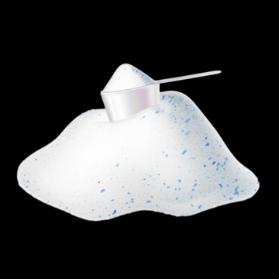
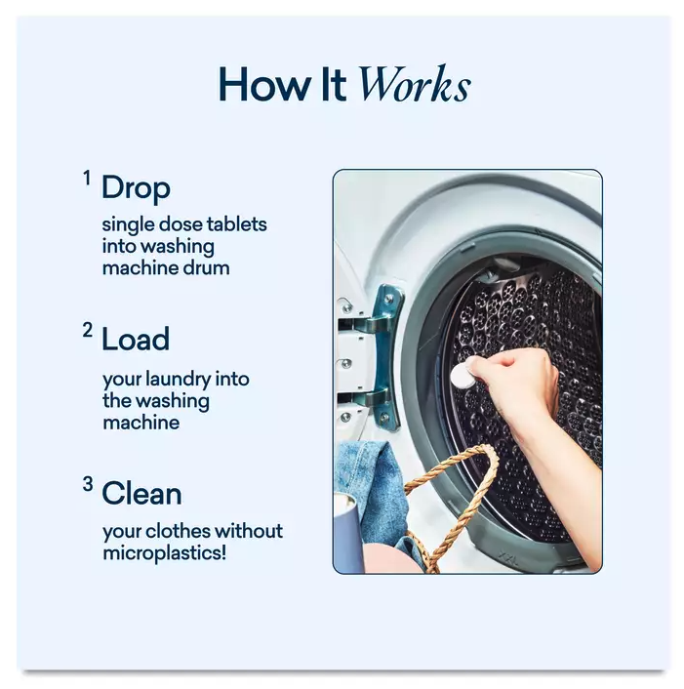
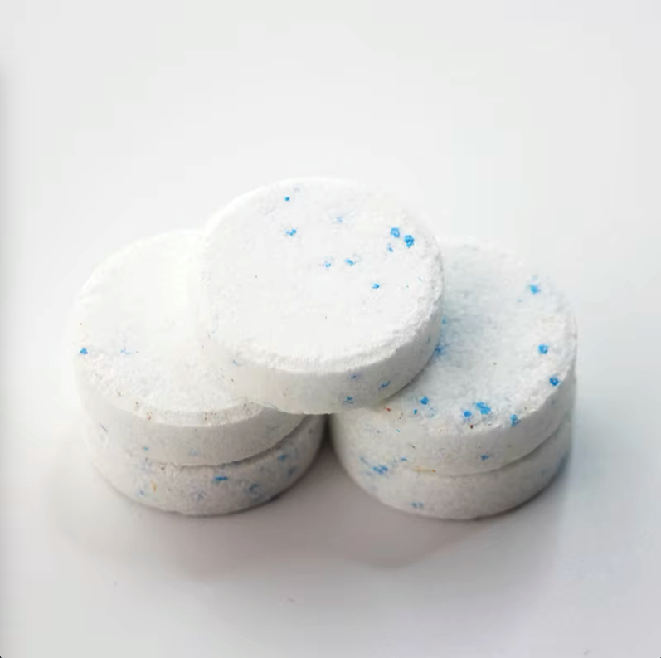
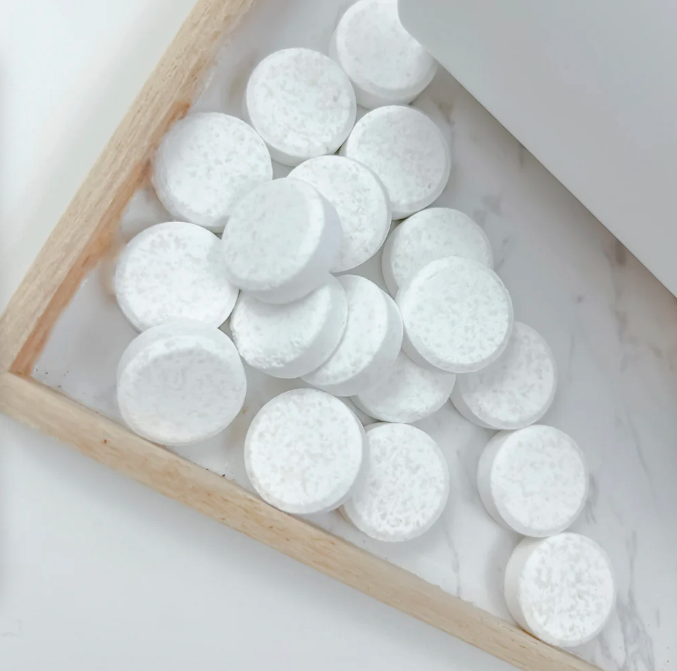
Solid soaps waterless formulations eliminate the need for phenoxyethanol & MIT
Dissolvable at-home
powder & tablets
Liquids
Solids
60–80% water
Plastic packaging
Preservatives
Waterless
Plastic-free packaging
Preservatives-free
Background | Approach | Strategies | Technical Performance | Human & Environmental Health | Remaining Questions | Alternatives
Notes:
Rosey Laundry Powder Ingredients:
Sodium Carbonate, Sodium Sulfate, Sodium Chloride, Sodium Carbonate Peroxide, Sodium Citrate, Protease Enzyme.
Sodium Citrate: While primarily used as a pH buffer or chelating agent, it can exhibit mild preservative properties by binding metal ions that may catalyze the degradation of the product or promote microbial growth.
Blueland Laundry Tablet Ingredients:
Sodium Carbonate, Citric Acid, Subtilisin, Microcrystal Line Cellulose, Alcohols C12-C14 Ethoxylated, Sodium Starch Glycolate, Amylase, Mannanase, Pectate Lyase, Lauryl/Myristyl Glucoside, Hydrated Silica, Cellulase
Sodium Carbonate: Not a preservative but can act as a pH stabilizer.
Citric Acid: While primarily used for pH adjustment, it can have mild preservative properties due to its ability to chelate metal ions and inhibit microbial growth indirectly.
Fig. Blueland https://thrivemarket.com/p/blueland-laundry-tablets-starter-set
https://roseray.com/products/roseray-gentle-eco-friendly-laundry-detergent-tablets
https://www.ecos.com/laundry/hypoallergenic-laundry-detergent-free-clear/
Fig. Powder and tablet stock images (no reference needed)

Slide 54
Machine learning can help design preservative-booster blends
Preservative-booster combinations can exhibit synergism (mixture is more potent than sum of its parts)
Many factors remain unexplored/unclear
Mechanism of action
Health hazards
Rational design principles
Machine learning workflow can help predict new preservative-booster blends
Data Collection & Processing
Model Training
Optimization
Experimental Validation
Extract features (structural info, pKa, MIC, etc.)
Train a regression model to predict MIC
Predict new effective preservative-booster blends
Testing MIC values in 96 well plates
Iterative design cycle
Background | Approach | Strategies | Technical Performance | Human & Environmental Health | Remaining Questions | Alternatives

Slide 55
Alternatives are promising with some considerations needed
Strategy | Pros | Cons
Carboxylic Acids | - Proven in food uses - Affordable | - Need low pH - Eye irritation
Rosemary Essential Oil and Willow Bark Extract | - Naturally derived | - Willow bark is only antibacterial - pH compatibility and dosage are questionable
Peptides | - Low toxicity - Used in food preservation | - Expensive to produce - Formulation compatibilities
Hydroxamic Acids | - Compatible pH range | - Ecotoxicity hazards
Esters | - Low hazards (sorbitan caprylate) - Antimicrobial efficacy (propyl gallate) | - pH compatibility - Hazards at lower concentrations
Polyols | - Lower concentration | - Aquatic toxicity and eye irritation -Efficacy when used alone
Phenyl Alkyl Alcohols | - Lower concentration (benzyl alcohol) | - Floral scent as a concern or use as fragrance
Notes:
We have evaluated a series of alternatives. Some of them have issues with toxicity and data gaps, performance, pH, accessibility are all things we have considered with each of the strategies. Remaining questions on the viability and consumer perception of these strategies that require consideration for our partner.
While 7 strategies show promise, several challenges and unknowns require further exploration:
1. Long-Term Efficacy
2. Formulation Challenges
3. Economic Viability
4. Comprehensive Toxicity Testing
5. Regulatory Approvals
These 4 strategies are the most viable alternatives:
Carboxylic Acid - The whole class
Peptides - ε-poly-L-lysine
Ester - Sorbitan caprylate and
Alcohols - benzyl alcohol

Slide 56
Thank You!
Jenna Arkin
Ryan Hood
Meg Schwarzman Billy Hart-Cooper
Megan Arnett Marty Mulvihill
Sara Tepfer Luke Elissiry
Tiffany Chen
QUESTIONS?

